Slide 1


Iris Dataset Analysis: Unveiling Insights with Machine Learning
Welcome to our journey into the fascinating world of machine learning, using the classic Iris dataset as our guide. We will explore data preprocessing, model implementation, visualization, and evaluation techniques to reveal hidden patterns and predict flower species.
by Vaishnavi

Slide 2


Slide 3
Exploring the Iris Dataset: Features and Target Variable
Features
Target Variable
Sepal length
Species
Sepal width
Iris setosa
Petal length
Iris versicolor
Petal width
Iris virginica

Slide 4
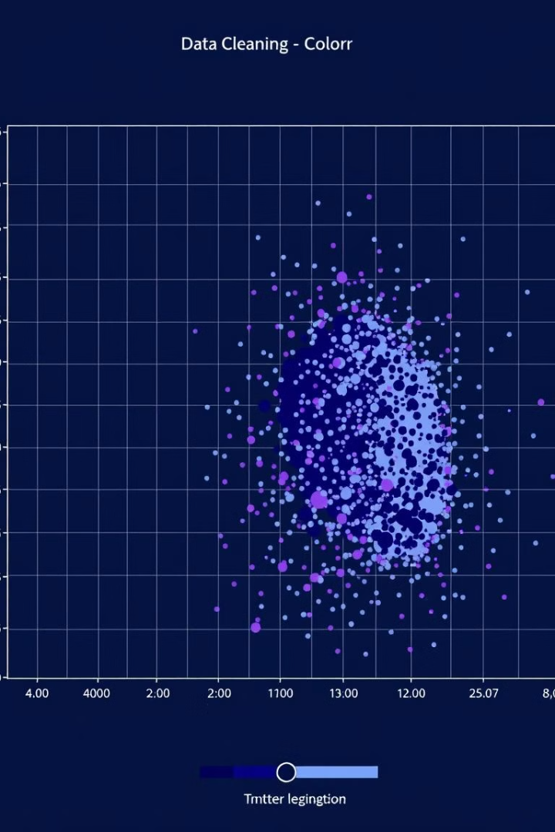
Data Preprocessing: Handling Missing Values and Scaling
Missing Value Imputation
Feature Scaling
Standardize features to a common scale, preventing bias towards features with larger values
Replace missing data points with mean or median values, preserving data integrity

Slide 5
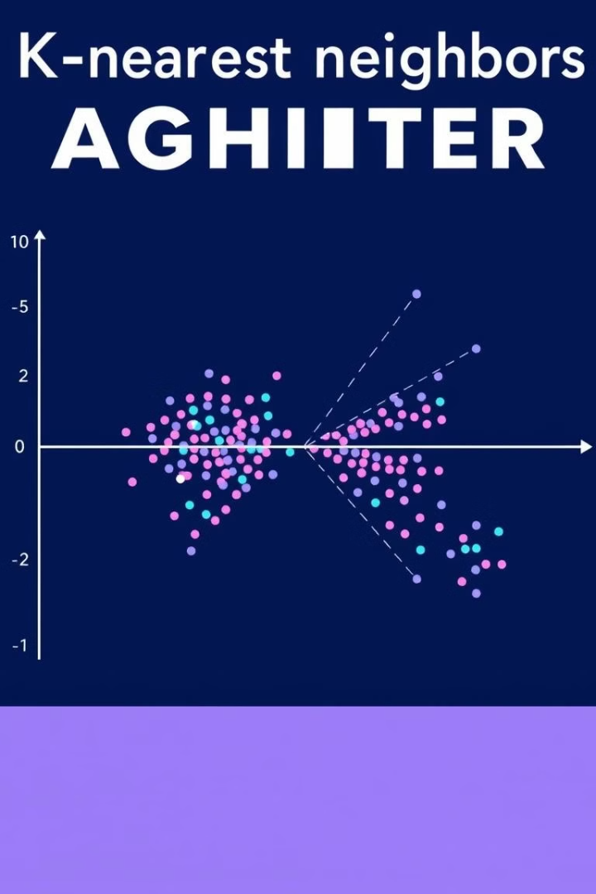


Implementing a Machine Learning Model: k-Nearest Neighbors and SVM
k-Nearest Neighbors (KNN)
Support Vector Machines (SVM)
Classifies new data points based on their proximity to known points
Creates a hyperplane to separate data points into distinct classes

Slide 6
KNN CLASSIFICATION ALGORITHM PRACTICALLY IMPLEMENTED

Slide 7
SUPPORT VECTOR CLASSIFICATION PRACTICALLY IMPLEMENTED

Slide 8
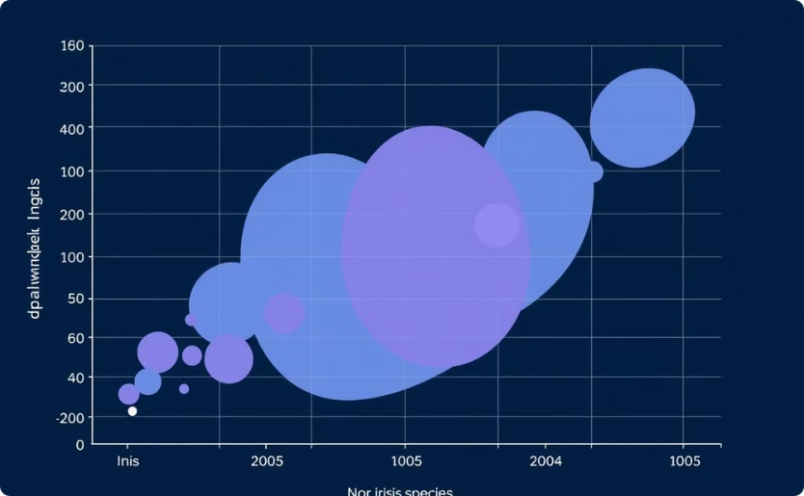
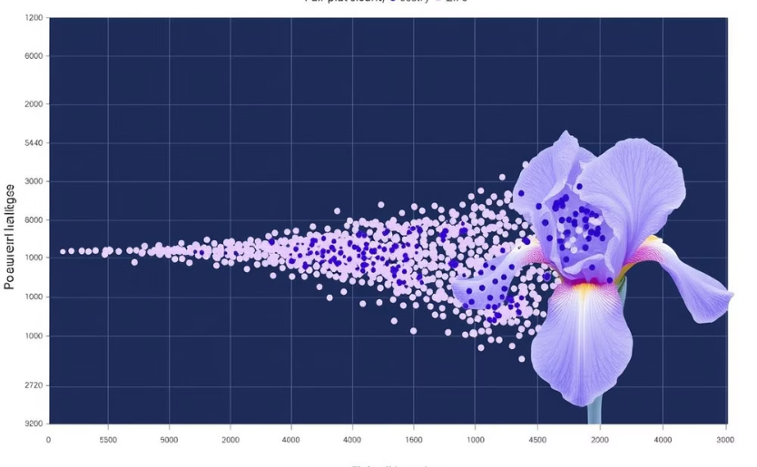
Visualizing Results: Scatter Plots and Pair Plots
Scatter Plot
Pair Plot
Visualize relationships between two features, identifying potential clusters
Explore relationships between all feature pairs, revealing complex interactions

Slide 9

Splitting the Dataset: Training and Testing
1
Training Data
2
Used to train the model, allowing it to learn patterns
3
Testing Data
4
Used to evaluate the model's performance on unseen data

Slide 10
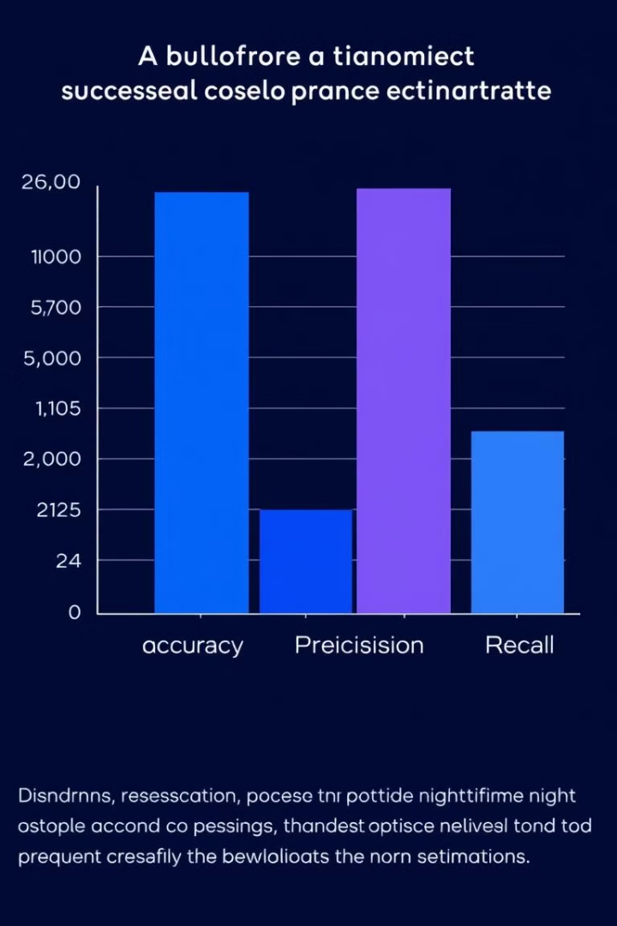
Evaluating Model Performance: Accuracy, Precision, and Recall
100%(using SVM)
Accuracy
The proportion of correctly classified instances
92%
Precision
The proportion of true positives among predicted positives
98%
Recall
The proportion of true positives among actual positives

